Slide 1

Image stitching with RANSAC
Eagle Eye
Image stitching has applications in many places, such as panoramic shooting in smartphone, high-precision map synthesis for aerial photography of drones, and medical image stitching. Image stitching with RANSAC has a wide range of applications in these areas.
1.Keypoint detector: SIFT/SURF
2.Find Homography with RANSAC
3.Stitching images with Center Sequence
Step 1:Stitch two images
Step 2:Stitch images in sequence
Step 3:Compare the result with PTGui (Pro Stitching software)

Slide 2
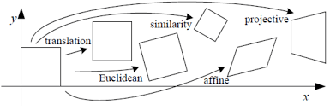
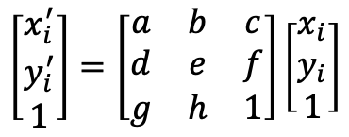
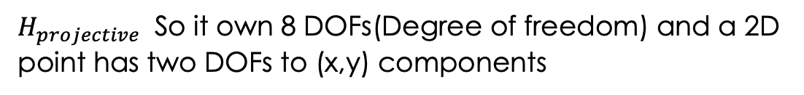
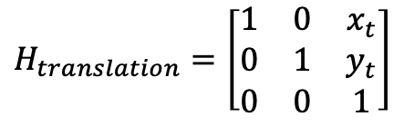
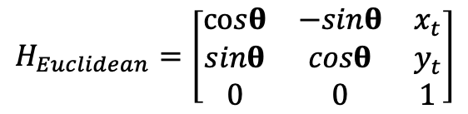
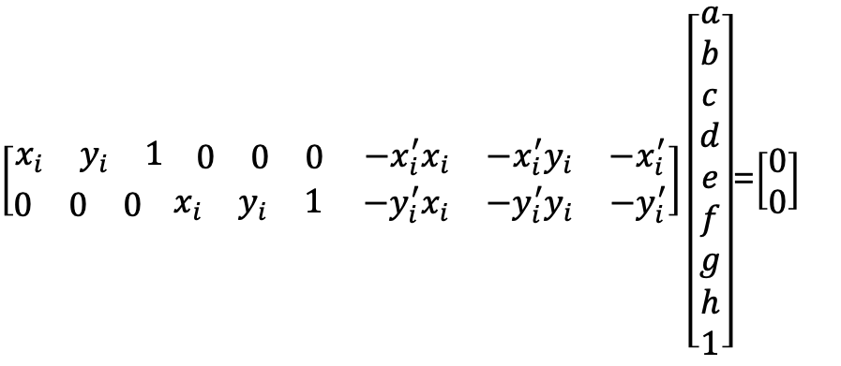
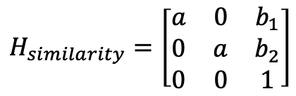
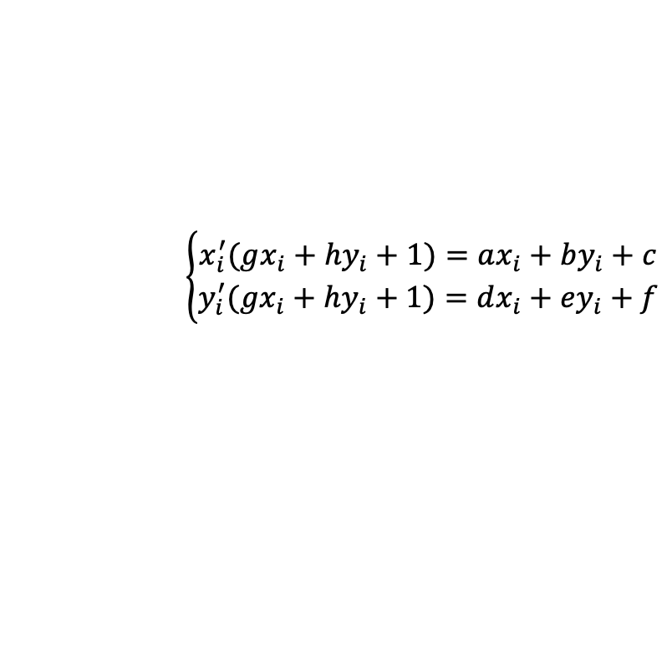
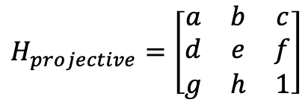
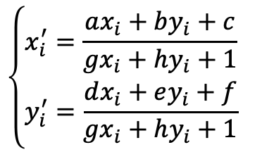
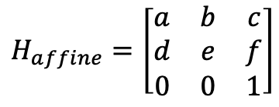
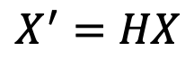
Compute Transformations
$$X^{′}=HX$$
$$H_{translation}=\left[\begin{matrix}1 & 0 & x_{t} \\ 0 & 1 & y_{t} \\ 0 & 0 & 1\end{matrix}\right]$$
$$H_{Euclidean}=\left[\begin{matrix}cosθ & −sinθ & x_{t} \\ sinθ & cosθ & y_{t} \\ 0 & 0 & 1\end{matrix}\right]$$
$$H_{similarity}=\left[\begin{matrix}a & 0 & b_{1} \\ 0 & a & b_{2} \\ 0 & 0 & 1\end{matrix}\right]$$
$$H_{affine}=\left[\begin{matrix}a & b & c \\ d & e & f \\ 0 & 0 & 1\end{matrix}\right]$$
$$\left\{\begin{aligned}x_{i}^{′}=\frac{ax_{i}+by_{i}+c}{gx_{i}+hy_{i}+1} \\ y_{i}^{′}=\frac{dx_{i}+ey_{i}+f}{gx_{i}+hy_{i}+1} \end{aligned}\right.$$
$$H_{projective}=\left[\begin{matrix}a & b & c \\ d & e & f \\ g & h & 1\end{matrix}\right]$$
$$\left[\begin{aligned}x_{i}^{′} \\ y_{i}^{′} \\ 1\end{aligned}\right]=\left[\begin{matrix}a & b & c \\ d & e & f \\ g & h & 1\end{matrix}\right]\left[\begin{aligned}x_{i} \\ y_{i} \\ 1\end{aligned}\right]$$
$$\left\{\begin{aligned}x_{i}^{′}(gx_{i}+hy_{i}+1)=ax_{i}+by_{i}+c \\ y_{i}^{′}(gx_{i}+hy_{i}+1)=dx_{i}+ey_{i}+f\end{aligned}\right.$$
$\left[\begin{aligned}\begin{matrix}x_{i} & y_{i} & 1\end{matrix} \begin{matrix}0 & 0 & 0\end{matrix} \begin{matrix}−x_{i}^{′}x_{i} & −x_{i}^{′}y_{i} & −x_{i}^{′}\end{matrix} \\ \begin{matrix}0 & 0 & 0\end{matrix} \begin{matrix}x_{i} & y_{i} & 1\end{matrix} \begin{matrix}−y_{i}^{′}x_{i} & −y_{i}^{′}y_{i} & −y_{i}^{′}\end{matrix}\end{aligned}\right]\left[\begin{aligned}a \\ b \\ c \\ d \\ e \\ f \\ g \\ h \\ 1\end{aligned}\right]$=$\left[\begin{aligned}0 \\ 0\end{aligned}\right]$
$H_{projective}$ So it own 8 DOFs(Degree of freedom) and a 2D point has two DOFs to (x,y) components

Slide 3
Stitching images with Center Sequence
4
2
1
3
zero
one
Mid
two
three
four
3
1
2
zero
Mid
one
two
three

Slide 4
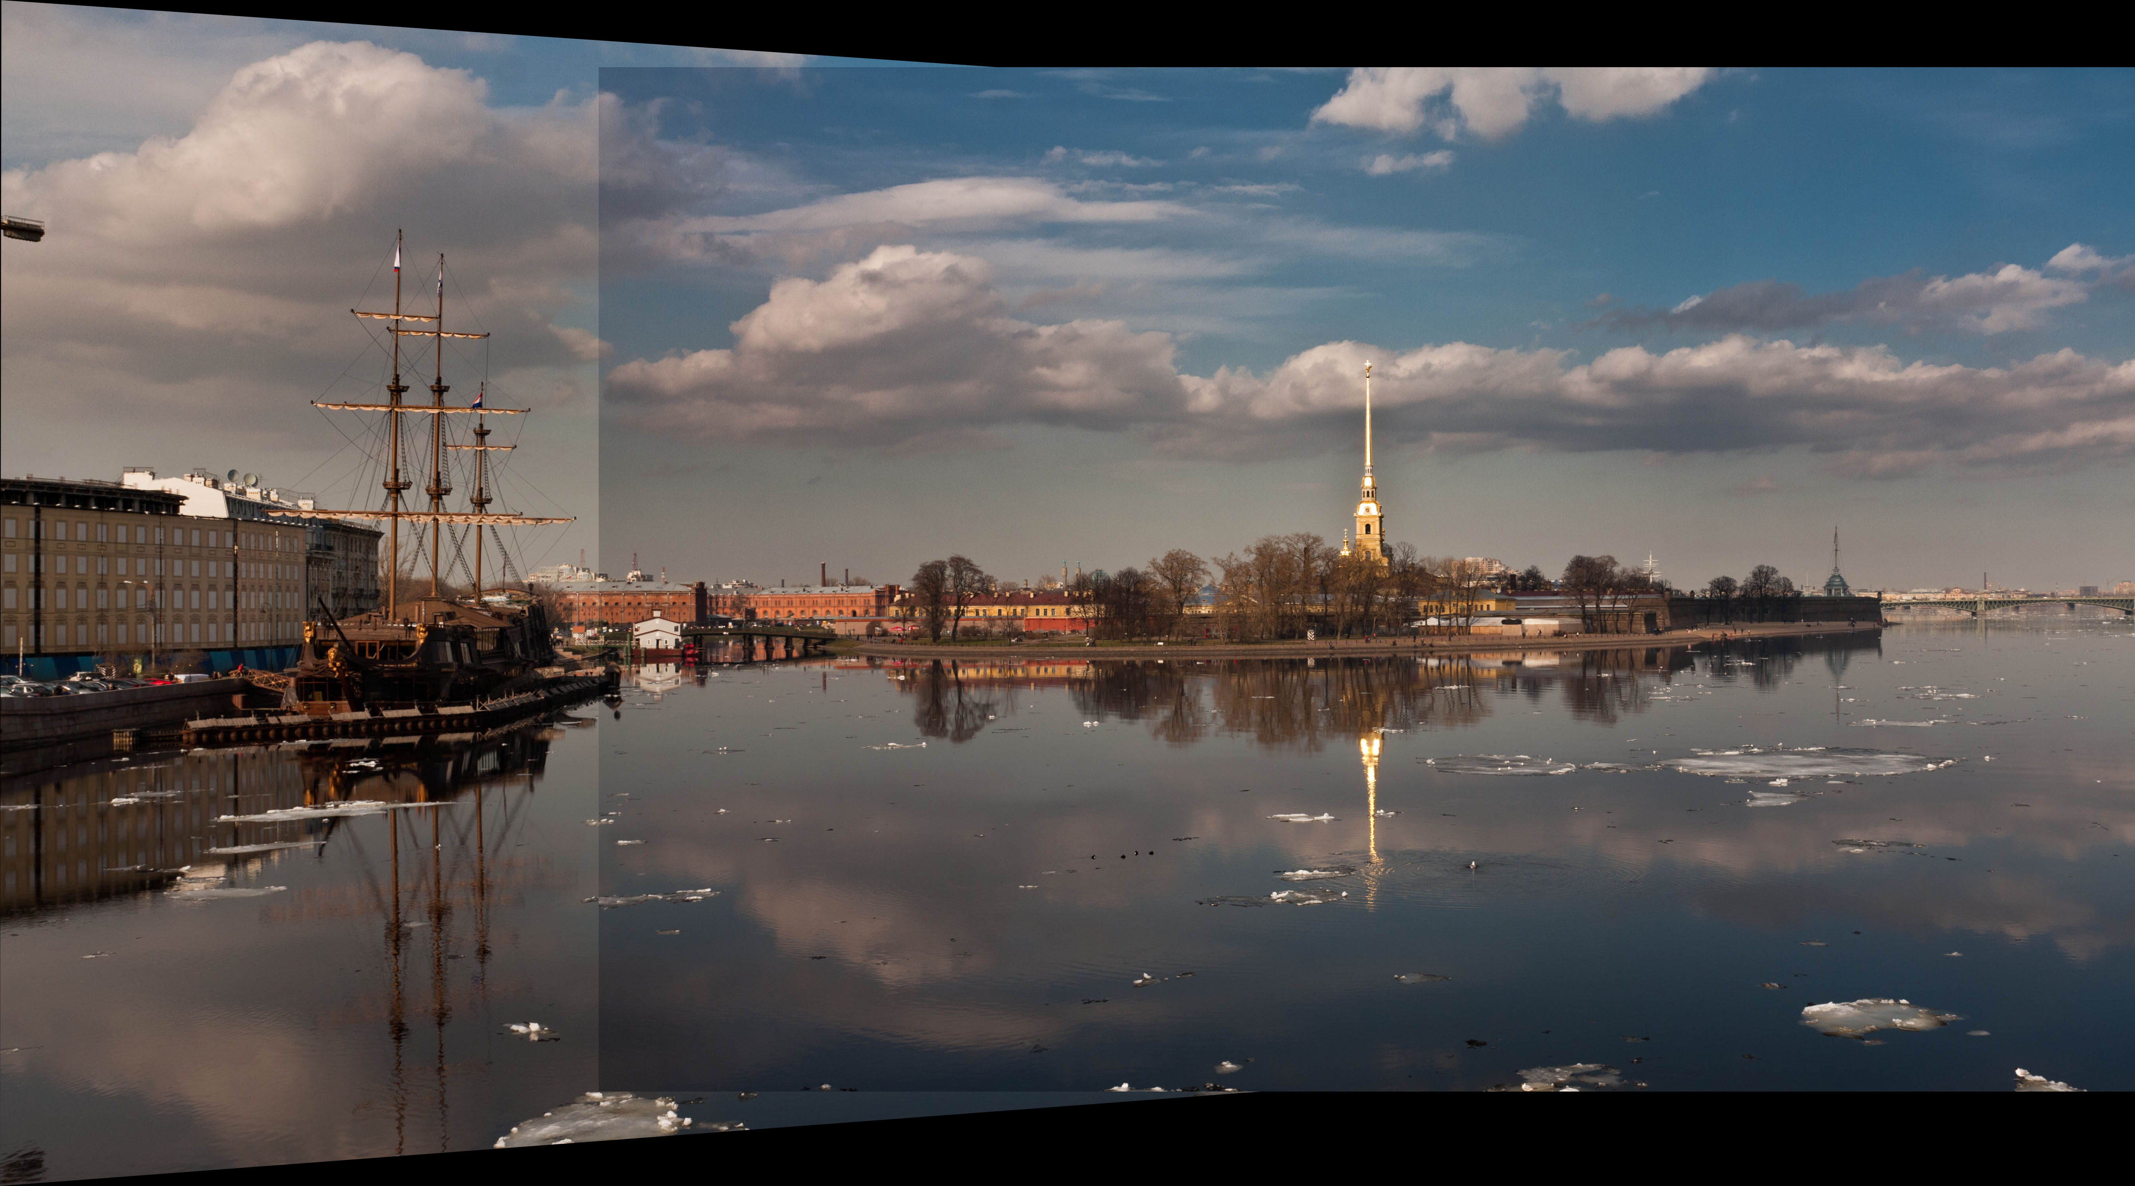
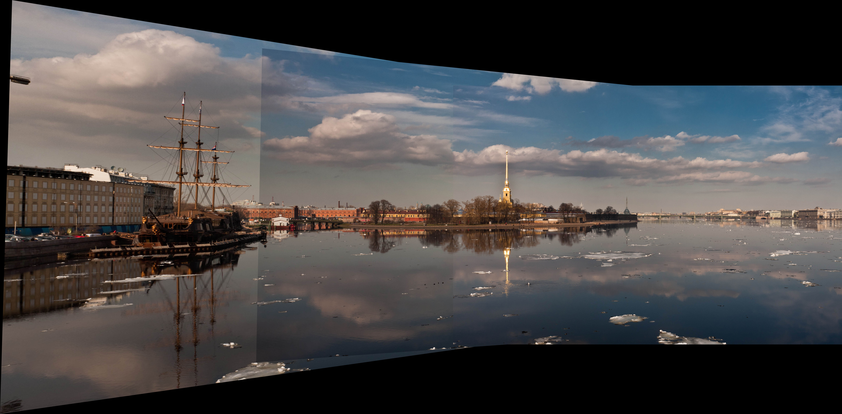
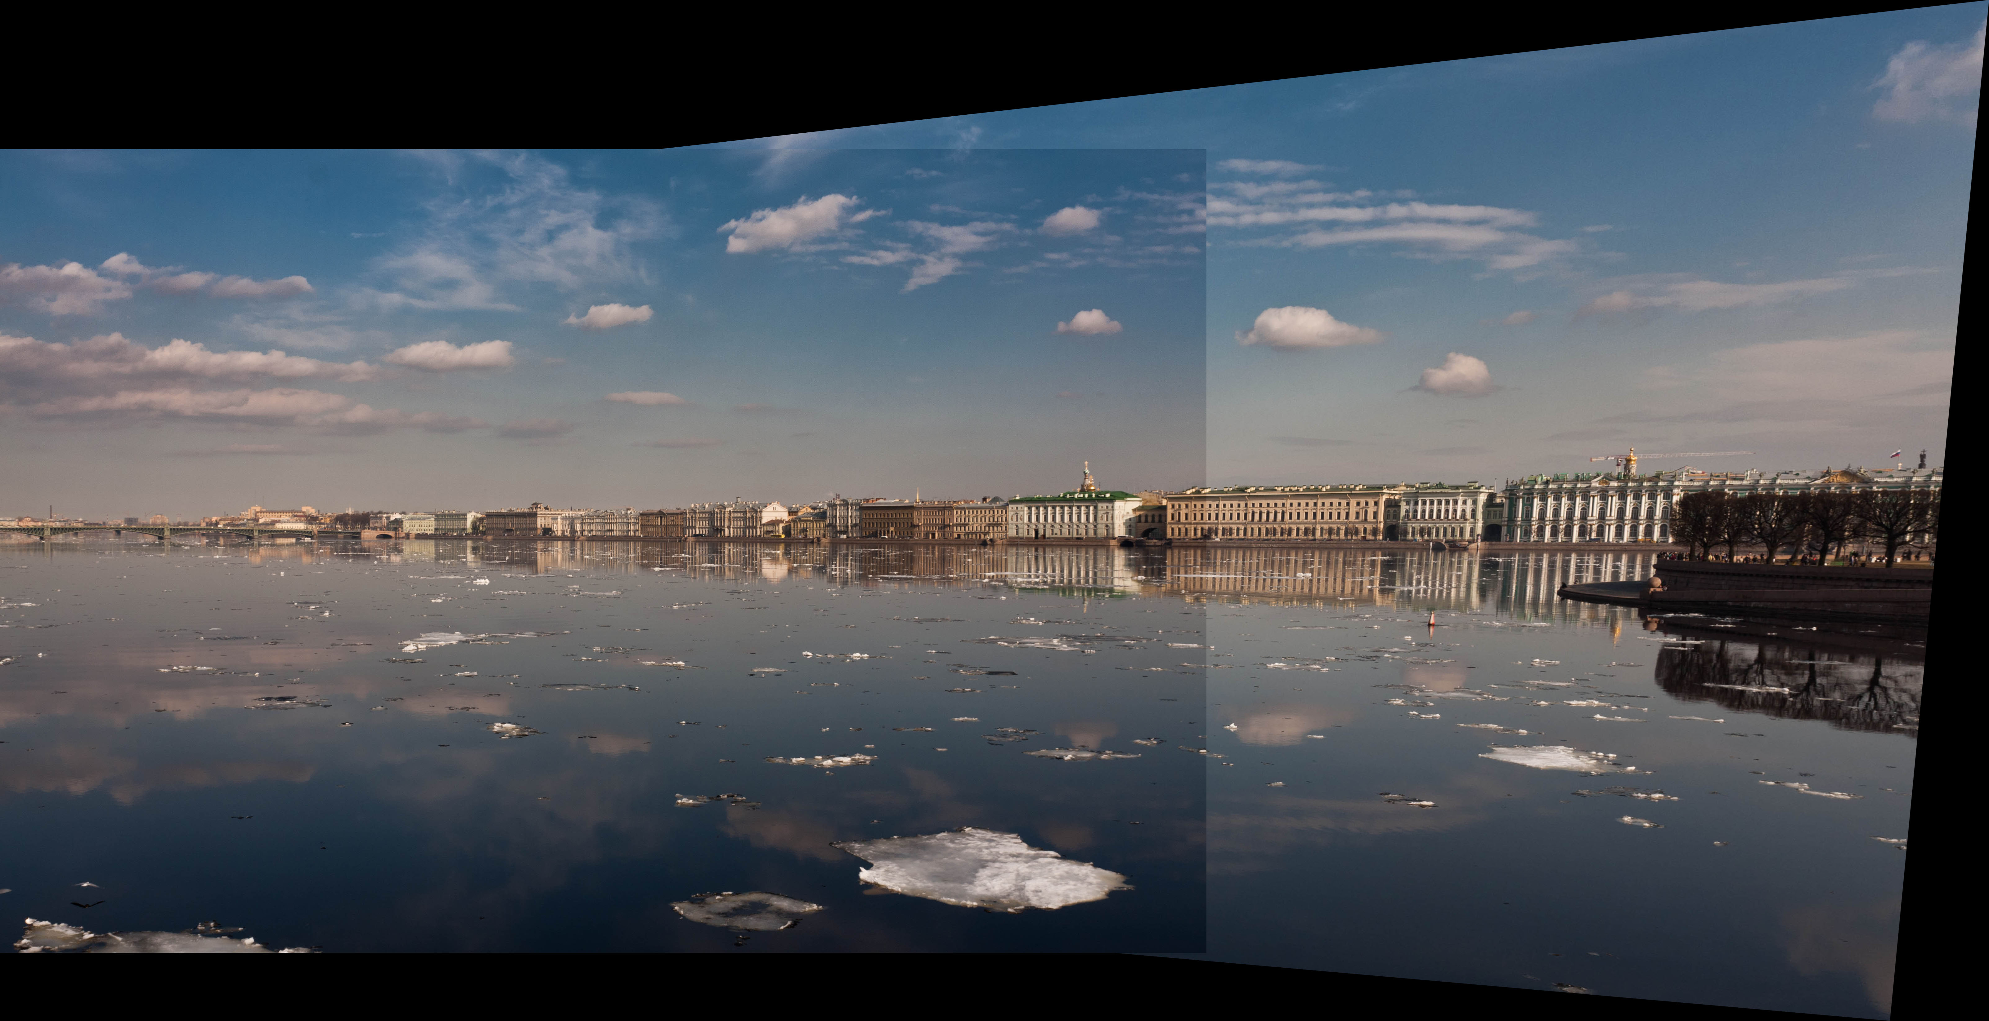
Stitching images with Center Sequence

Slide 5
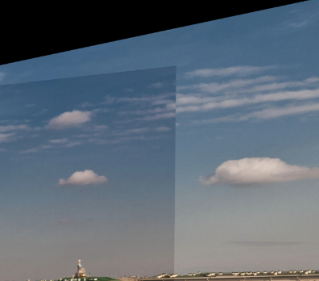
Compare Our Panorama with PTGui

